Slide 1

Data Analytics Assignment
By Qayyim Syahmi

Slide 2
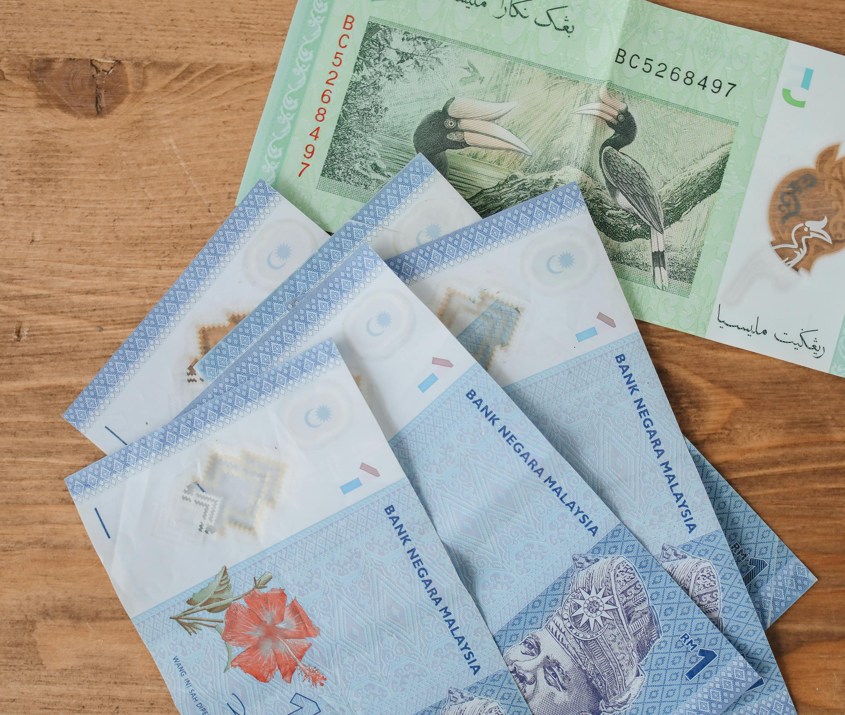
Un-covering the Insurance Products for HBA
Total Sum Assured
What’s the relationship between
the Sum Assured & the Premiums?
Negative Correlation
Unique Premium Structure or Product Design
Imbalances
Client’s Financial Status
Risk Assessment
Opportunities in the Discrepancies
Insurance Product Type
Total Chargeable Premiums
Insurance Product Type

Slide 3

Assessing HBA’s Financial Performance
RM 1.57 billion
Total Sum Assured
2.78%
Loss Ratio
4,017
Number of Policies
RM 41.74 million
Total Premiums Charged
143k
Client Lifetime Value
3,874
Number of Clients

Slide 4

The Business Problems
Addressing the disparity between Sum Assured and Premiums to be Paid
At first glance, the Average of Sum Assured per plan for Product E is relatively lower for it’s the Average Secured Premiums to be paid per plan (x37,860), as compared to Product A (x18,755)
Pricing strategy must align with set of criteria for “re-balancing”, for all product offerings
Reducing Loss Ratios/Premiums Loss while identifying the root causes
Product E and Product A contributes to losses in terms of Premiums received since Jan 2020 – June 2020
Finding the probable causes that contributing to high Loss Ratios/Premiums Loss

Slide 5





Disparity between Sum Assured and Modal Premiums for each Products
As a result, out of 4,017 policies,
the premiums charged can be segmented:
Step1: Data Segmentation
Segment Policies into product groups
Step 2: Calculate statistical measures for each Product Types
Sum Assured: Median
Modal Premiums: Mean
Step 4: Analyze the discrepancies
Identify which policies where the Sum Assured is significantly above or below the median
Identify which policies where the median Modal Premiums is significantly above or below the mean
Step 3: Identify imbalances
Compare each policies against the median Sum Assured & the mean Modal Premiums of its product group

Slide 6
Without the Imbalance Segmentation
Observing with clarity
Product D and Product E have similar Premiums Secured even though the Sum Assured for Product D is different (highly skewed)
Assumption: Product E and Product A are designed where Product E to make it more accessible to wide range of clients (as Product E have more clients ranging from Q1 to Q4)
Income Distribution:
Q1: 25% of the overall percentile (when ordered)
Q2: 50% of the overall percentile (when ordered)
Q3: 75% of the overall percentile (when ordered)
Q4: 100% of the overall percentile (when ordered)
Secured Premiums:
Types of premiums that have guaranteed revenue for the company, according to the policy status of policy holders [ Modal Premiums x Payment Mode; if Payment Mode = 0, considered as 1]

Slide 7
With the Imbalance Segmentation
Policies Subscribed
Overall, imbalances occurred across all Product Types, where the range of % within the Product Type 20% - 25%

Slide 8
With the Imbalance Segmentation
Sum Assured
Premium High, Coverage High and Premium Low, Coverage High remained as the dominant segments across all Products Types
Exceptionally large portion of Premium Low, Coverage High dominating the Product C
Amongst all Product categories, Premium Low, Coverage Low is most prominent in the Product D
Product E and Product A has a similar distribution
Overall, across all product, the distribution of High Coverage segment is higher than Low Coverage segment
Premiums Secured
In contrast, Premium High, Coverage High and Premium High, Coverage Low are two most dominant segments across all Product Types
More than 10% within each Product category have policyholders with the status of Premium Low, Coverage Low
Product E and Product D has a similar distribution
Product A have one of the highest segment for Premium High, Coverage Low
Overall, the distribution of High Premiums segment that are guaranteed revenue is higher than Low Premiums segment

Slide 9
Premiums Earned and Premiums Losses
Sustainable Growth
May-20 to June-20 (MoM%)
+144.39%
Mar-20 to Apr-20 (MoM%)
-49.00%
Throughout all policies, the Total Premiums Earned:
Type E RM 27.00 mil
Type A RM 14.29 mil
Type C RM 222.53 k
Type D RM 218.32 k
Identifying the losses
Overall, RM 1.16 mil premiums are lost
Narrowing down on which products contributed

Slide 10
Assumptions on the Premiums Losses
Situations that leads to losses:
Cancelled During Cooling Off Period
Premiums Paid returned in full
Non-Disclosure Cancellation
Premiums Paid can be returned if the policy is voided ab inito (from the beginning)
Surrendered
Client may receive cash surrendered value (less than the total Premiums Paid)
Auto-Surrendered
Clients may receive cash surrendered value (not a full refund of the total Premiums Paid)
These are the assumptions of the “Premiums Losses”…

Slide 11
Premium Losses with Imbalance Segmentation
Filtering insurance plans whose policies have premiums considered as loss to the organization tells us that…
The major contributor to the Premium Losses for Product A:
Premium High, Coverage Low
The major contributor to the Premium Losses for Product E:
Premium High, Coverage High

Slide 12

Root Causes Analysis
Review

Slide 13
Using Tree Decomposition Technique to Identify which variables lead to Premium Losses
Out of RM 1,158,828 Premiums Losses…
variable 1
Payment Mode 12 (87%)out of RM 1,158,828
Payment Mode = 12, where premiums are paid only once a year
contributes RM 1,008,048
variable 2
Insurance Product E (81%) out of RM 1,008,048
Insurance Product E, one of the most chosen
policy out of all product offerings contributes RM 821,280
variable 3
Marital Status M (68%) out of RM 821,280
Married policyholders contributes RM 560,472
variable 4
Gender Male(54%) out of RM 560,472
Male policyholders contributes RM 304,944
variable 5
Income Bands Q1(55%) out of RM 304,944
Lowest quartile (25%) of the Income Bands contributes RM 166,392
variable 6
Selangor Residence (50%) out of RM 166,392
Policyholders reside in Selangor contributes RM 83,784

Slide 14
Using Tree Decomposition Technique to Identify which variables lead to Premium Losses
Out of RM 252,802 Premiums Losses for Product A
variable 1
Payment Mode 12 (70%)out of RM 253,802
Payment Mode = 12, where premiums are paid only once a month
contributes RM 186,768
variable 2
Gender Female (69%) out of RM 186,768
Female policyholders contributes RM 128,808
variable 3
Income Bands Q2(62%) out of RM 128,808
2nd Lower quartile (50%) of the Income Bands contributes RM 80,244
variable 4
Age Group B (62%) out of RM 80,244
Age Group B contributes RM 49,476
variable 5
Marital Status S (100%*) out of RM 49,476
Married policyholders contributes RM 49,476
variable 6
Selangor Residence (61%) out of RM 49,476
Policyholders reside in Selangor contributes RM 30,265
*Age Group B mostly comprises of Single Marital Status

Slide 15
Using Tree Decomposition Technique to Identify which variables lead to Premium Losses
Out of RM 905,026 Premiums Losses for Product E
variable 1
Payment Mode 12 (91%)out of RM 905,026
Payment Mode = 12, where premiums are paid only once a month
contributes RM 821,280
variable 2
Marital Status M (68%) out of RM 821,280
Married policyholders contributes RM 560,472
variable 3
Gender Male(54%) out of RM 560,472
Male policyholders contributes RM 304,944
variable 4
Income Bands Q1(55%) out of RM 304,944
Lowest quartile (25%) of the Income Bands contributes RM 166,392
variable 5
Selangor Residence (50%) out of RM 166,392
Policyholders reside in Selangor contributes RM 83,784
variable 6
Age Group B (37%) out of RM 83,784
Age Group B contributes RM 30,816

Slide 16

Conclusion

Slide 17



Recommendations
Adjust Pricing Strategies
Adjust pricing strategies for Product A and Product B to reduce premium losses
Flexible Payments
Offer flexible payment modes to reduce the impact of annual payments default
Customize product for better market fit
Tailor policies and communication for specific demographics groups

Slide 18
Tools Used
Python
Excel
SQL
Microsoft PowerBI

